Slide 1
Bio & 241 A&P
Unit 1 / Lecture 3

Slide 2
Tissues
All body tissues arise from three fundamental embryonic tissues.
  Endoderm: forms epithelial tissues lining internal organs such as the GI tract
  Mesoderm: connective tissue associated with dermis of skin, cartilage, bone
  Ectoderm: forms nervous tissue and epidermis of skin.
FOUR TYPES OF BODY TISSUE:
Epithelial
Connective (most abundant tissue in the body)
Muscle
Nervous
* In this unit we will explore Epithelial and Connective tissues*

Slide 3
Epithelial Tissue -- General Features
Closely packed cells with little extracellular material
  Many cell junctions often provide secure attachment.
Cells sit on basement membrane
  Apical (upper) free surface
  Basal surface against basement membrane
Avascular---without blood vessels
  nutrients and waste must move by diffusion
Good nerve supply
Rapid cell division (high mitotic rate)
derived from ALL three primary germ layers:
  ectoderm, endoderm, and mesoderm
Functions
  protection, filtration, lubrication, secretion, digestion, absorption, transportation, excretion, sensory reception, and reproduction.

Slide 4
Types of Epithelium
Covering and lining epithelium
  epidermis of skin
  lining of blood vessels and ducts
  lining respiratory, reproductive, urinary & GI tract
Glandular epithelium
  secreting portion of glands
  thyroid, adrenal, and sweat glands

Slide 5
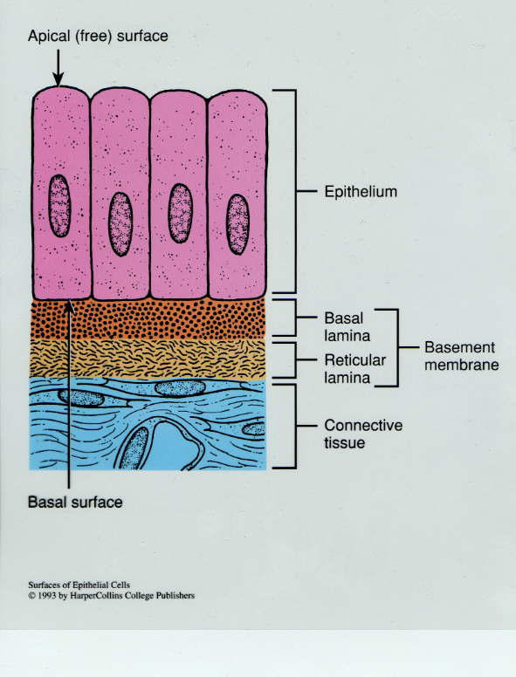
Typical Arrangement
of Epithelial Tissue and its Basement Membrane

Slide 6
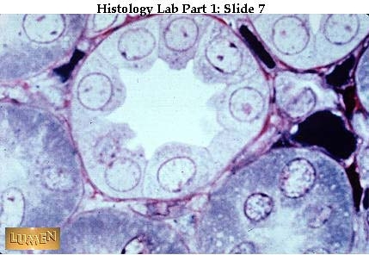
Typical Microscopic View of Epithelial Cells
and its Basement Membrane
Basement membrane

Slide 7
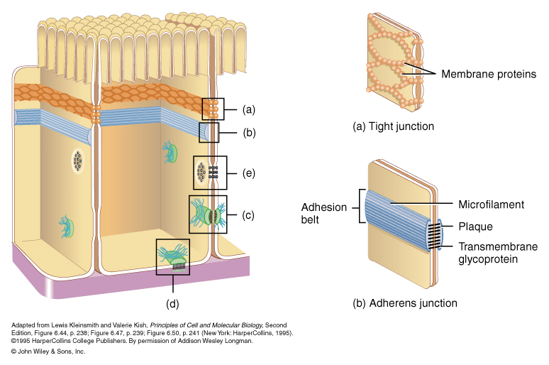
Cell Junctions
Tight Junctions: Prevent the movement of fluids between cells
Adherens Junctions:
(Belt desmosome)
Help prevent cells from being separated at the apical surface
Button Desmosomes: Attach cells to adjacent cells

Slide 8
Cell Junctions
Hemidesmosomes: Attach cells to extracellular materials such as a basement membrane

Slide 9
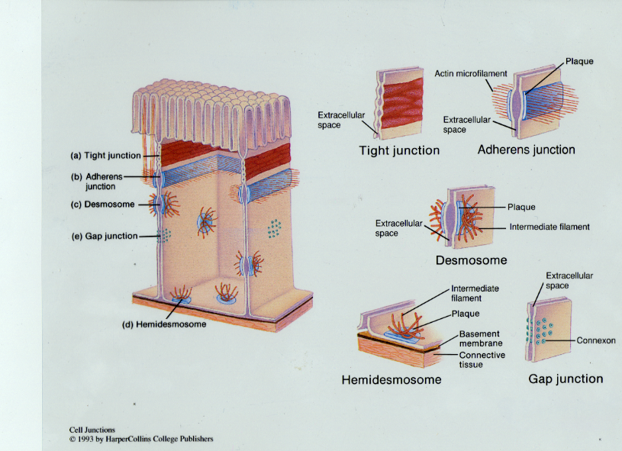
Types of Cell Junctions

Slide 10
Epithelial Tissues
These tissues are classified according to the arrangement of cells and the shape of cells
Arrangement:
    Simple
    Stratified
    Pseudostratified

Slide 11
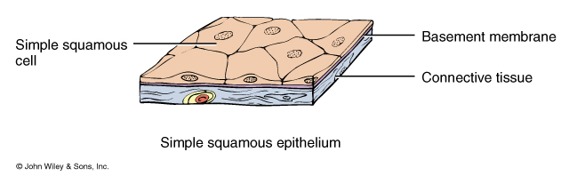
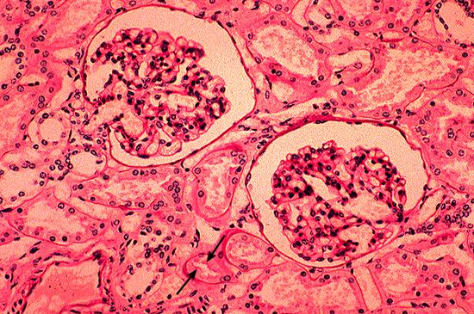
Simple

Slide 12
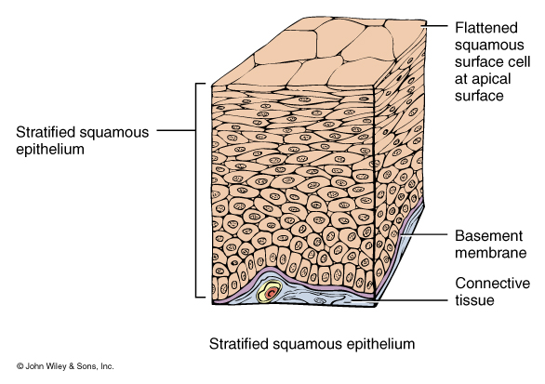
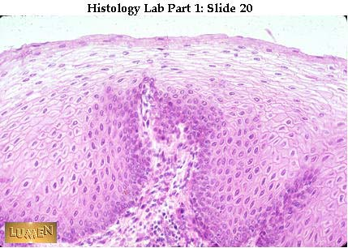
Stratified

Slide 13
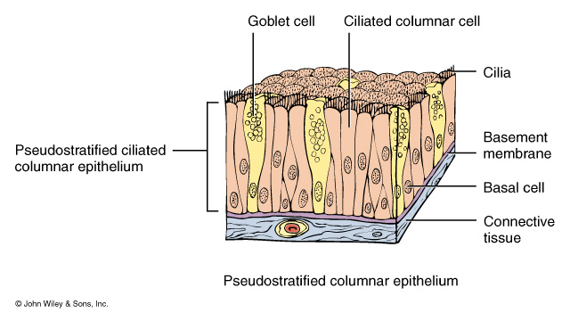
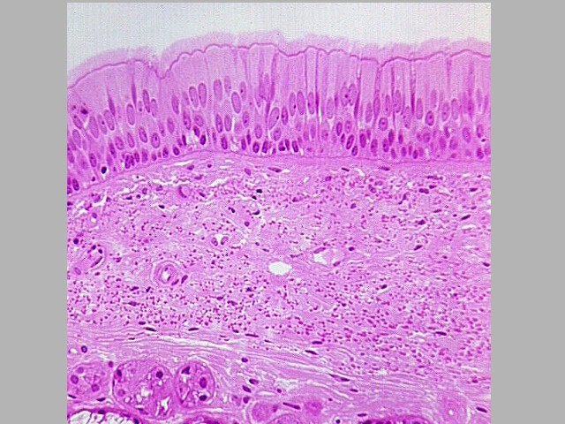
Pseudostratified

Slide 14
Epithelial Tissues
2. Cell Shape
a. flat or squamous
b. cube or cuboidal
c. cylindrical or columnar
d. changing shape or transitional

Slide 15
Simple Epithelium
Simple squamous epithelium consists of a single layer of flat, scale-like cells
  adapted for diffusion and filtration (found in lungs and kidneys)
  Endothelium lines the heart and blood vessels.
  Mesothelium lines the thoracic and abdominopelvic cavities and covers the organs within them as part of Serous Membranes
Simple cuboidal epithelium consists of a simple layer of cube-shaped cells
  adapted for secretion and absorption (found in the kidneys and thyroid gland)

Slide 16
Simple Epithelium
Simple columnar epithelium consists of a single layer of rectangular cells and can exist in two forms
  Nonciliated simple columnar epithelium contains microvilli
    increase surface are and the rate of absorption
    goblet cells secrete mucus
    Found lining the stomach, small intestines, and large intestines.

Slide 17
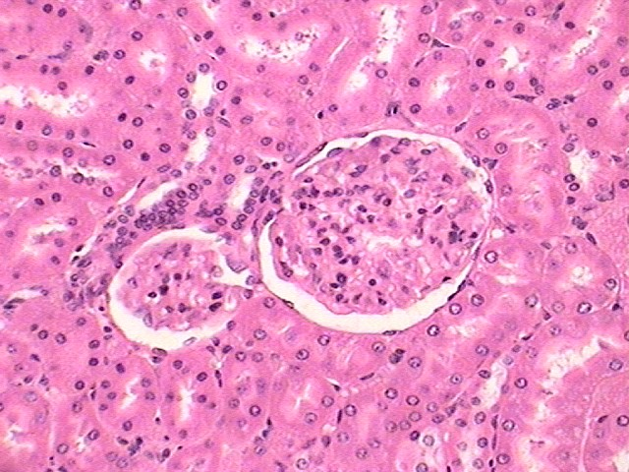
Squamous

Slide 18
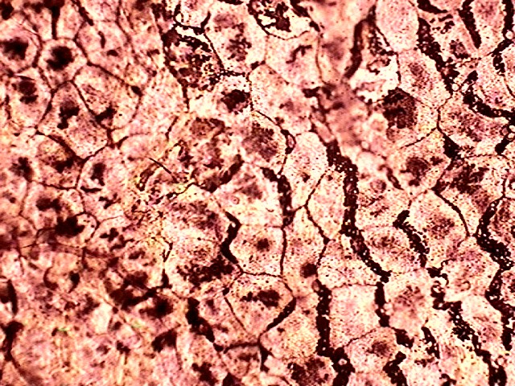

Slide 19
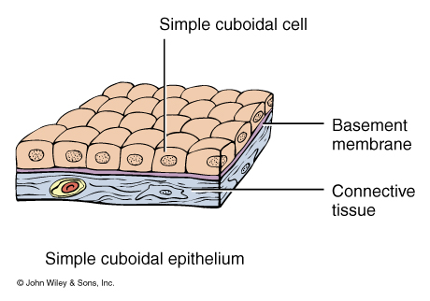
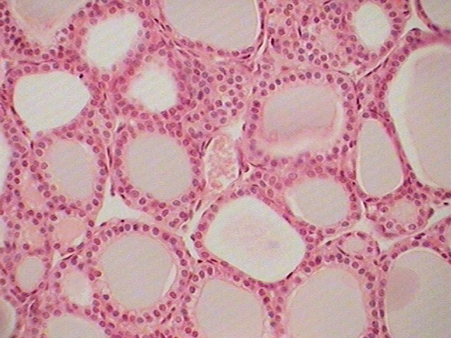

Slide 20
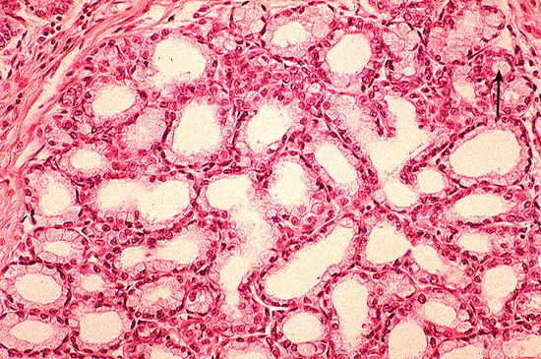
Simple Cuboidal

Slide 21
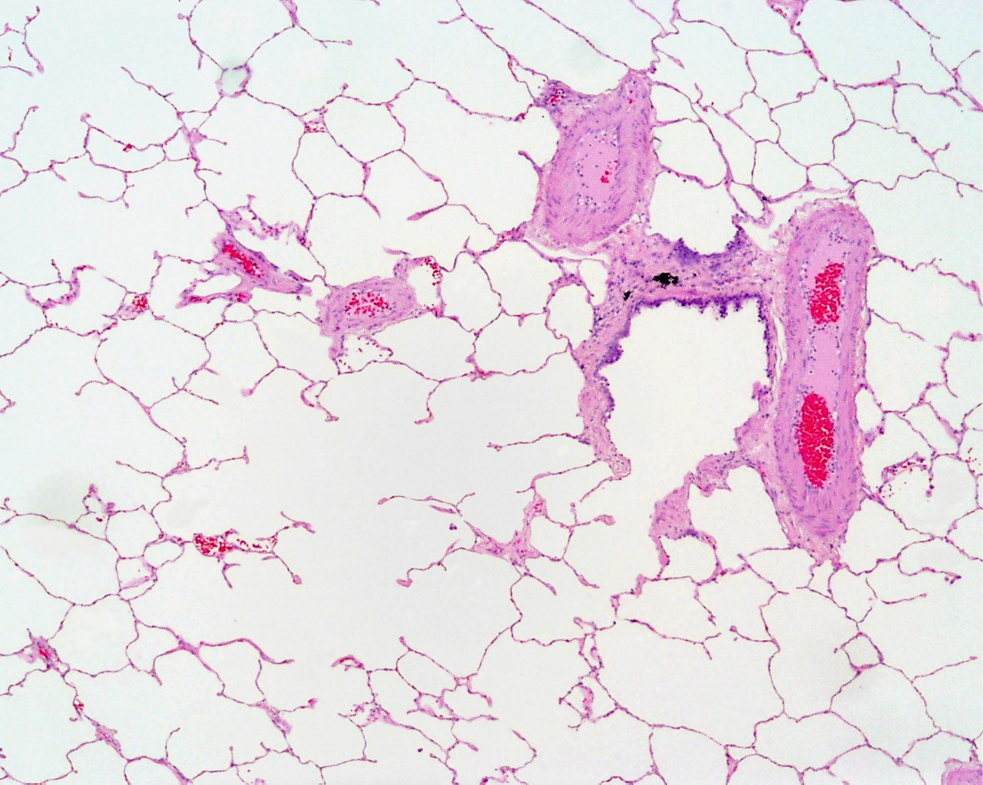
Simple Squamous
Simple Squamous
Lung Tissue
Kidney Tissue

Slide 22
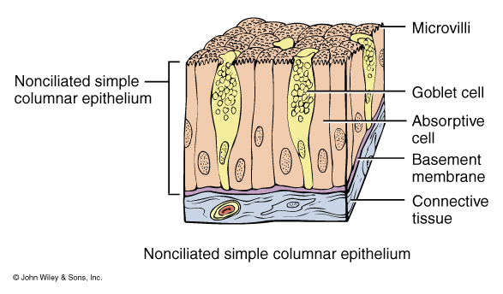
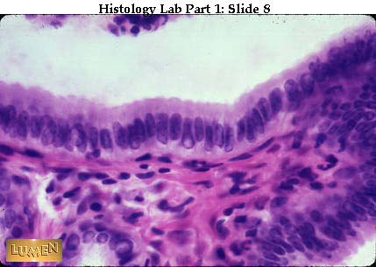

Slide 23
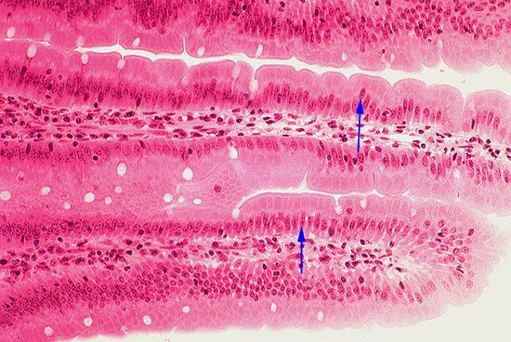
Simple Columnar

Slide 24
Pseudostratified Epithelium
Pseudostratified epithelium: appears to have several layers because the nuclei are at various levels.
All cells are attached to the basement membrane but some do not reach the apical surface.
In pseudostratified ciliated columnar epithelium, the cells that reach the surface either secrete mucus (goblet cells) or bear cilia that sweep away mucus and trapped foreign particles.
Found lining the respiratory system.

Slide 25
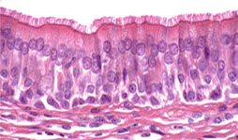
Pseudostratified

Slide 26
Stratified Epithelium
Epithelia have at least two layers of cells.
  more durable and protective
  name depends on the shape of the surface (apical) cells
Stratified squamous epithelium consists of several layers of
  top layer of cells is flat
  deeper layers of cells vary cuboidal to columnar.
  basal cells replicate by mitosis
Keratinized stratified squamous epithelium
  a tough layer of keratin (a protein resistant to friction and repels bacteria) is deposited in the surface cells.
Nonkeratinized epithelium remains moist.

Slide 27
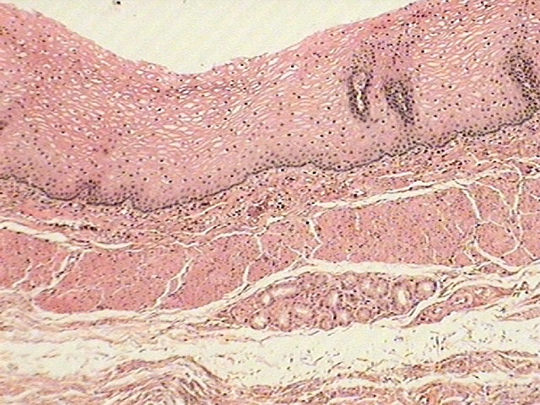

Slide 28
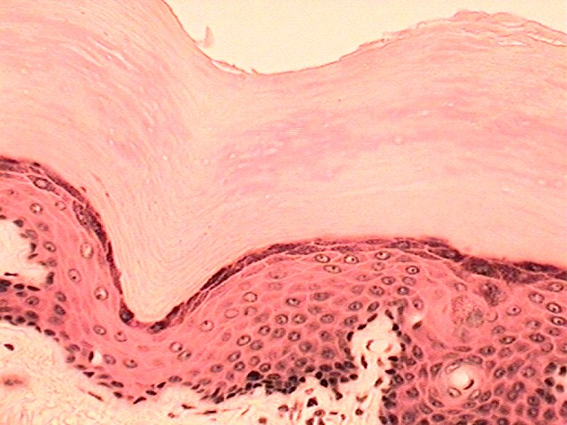

Slide 29
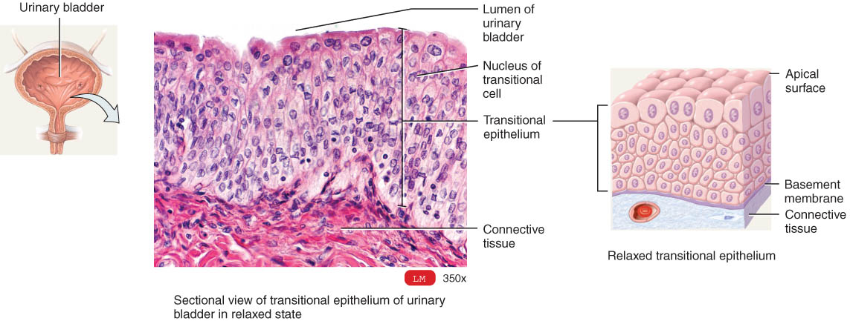
Transitional Epithelium
Multilayered
  surface cells varying in shape
    round to flat (if stretched)
  lines hollow organs that expand from within (urinary bladder)

Slide 30
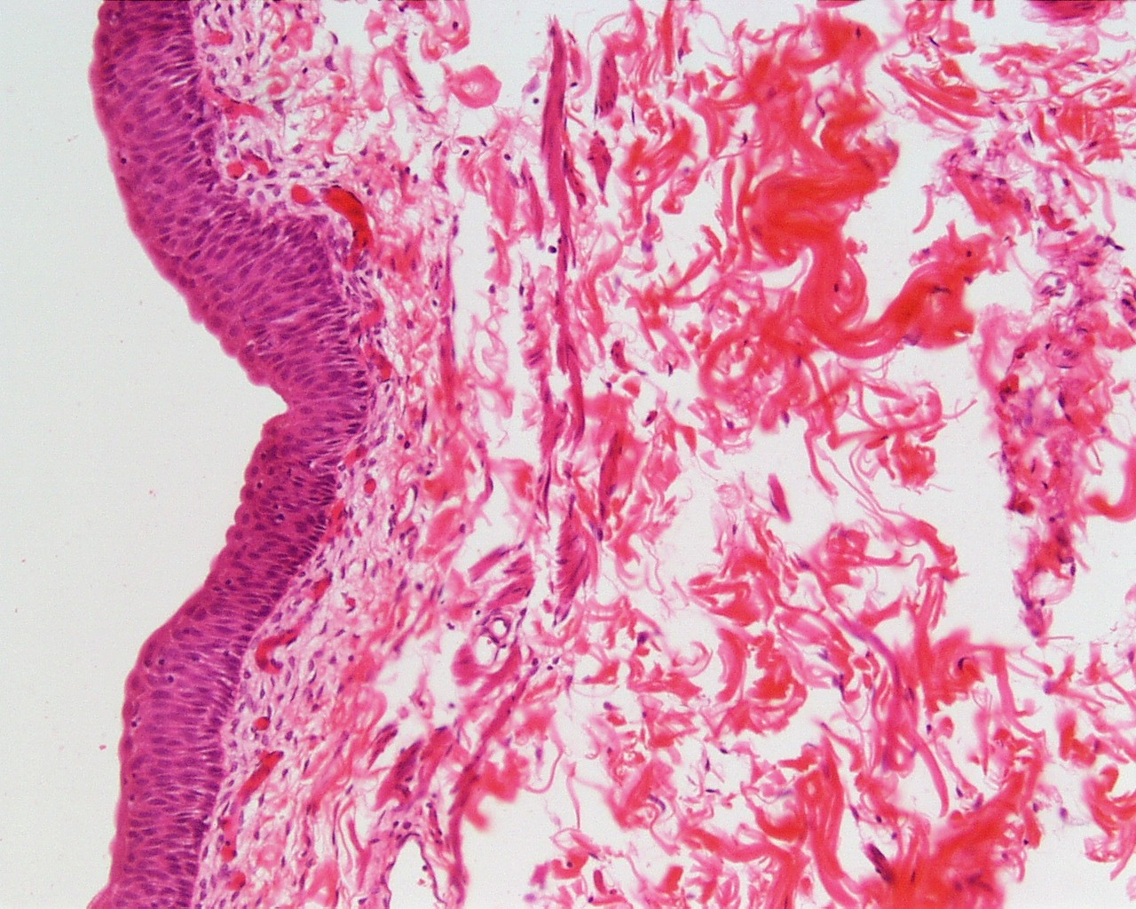
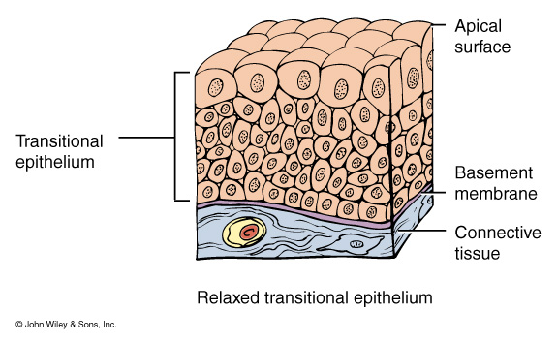

Slide 31
For each type of tissue you need to know
Description
Example of location
Function

Slide 32
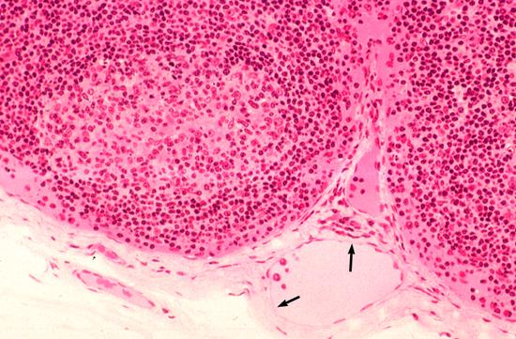

Slide 33
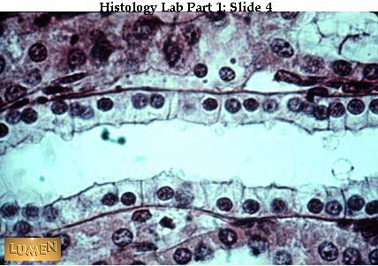

Slide 35
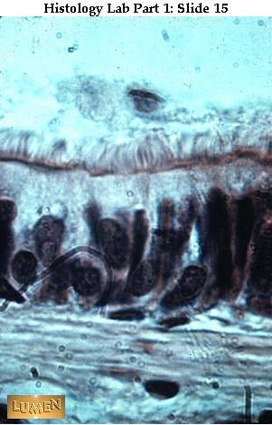

Slide 36
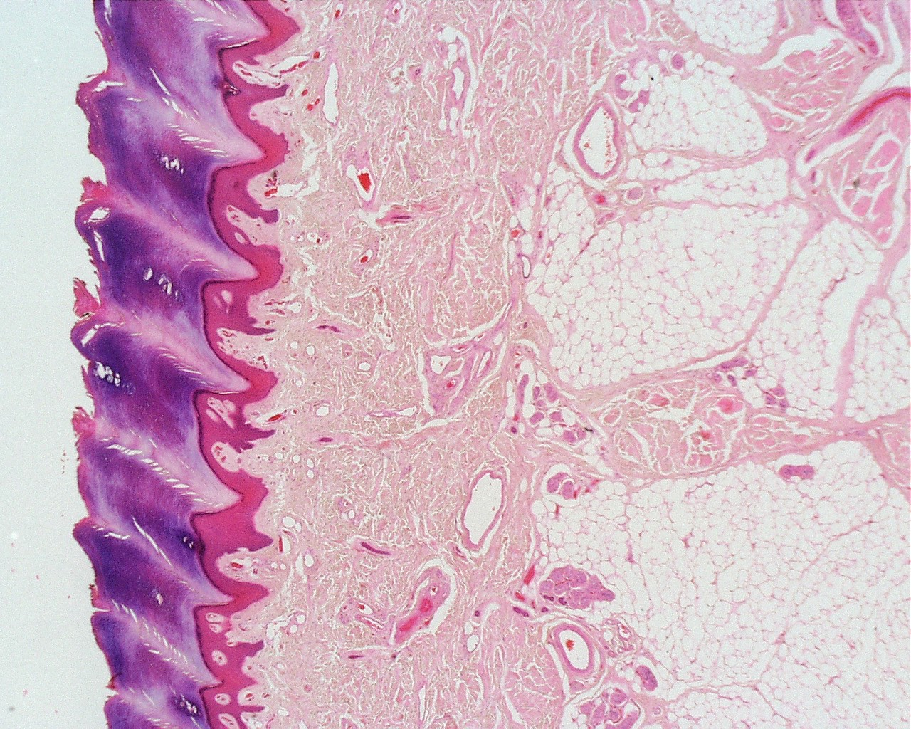

Slide 37
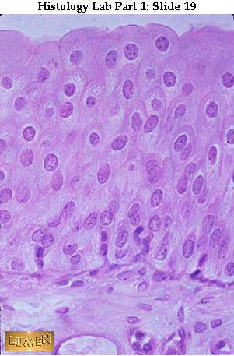

Slide 38
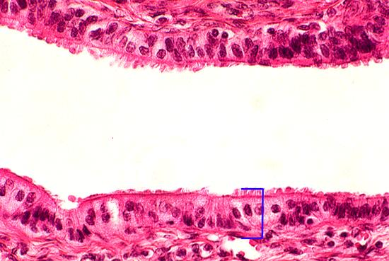

Slide 39
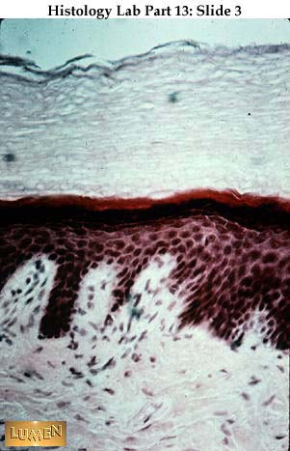

Slide 42
